Slide 1
Lecture 11
Signals and Systems (ELL205)
By Dr. Abhishek Dixit
Dept. of Electrical Engineering
IIT Delhi

Slide 2
Outline of the lecture
System designing

Slide 3
Basic DT system
Basic characteristics:
Linear (if delay starts at rest)
Time-Invariant
Causal
Recipe system
FIR system
Delay

Slide 4
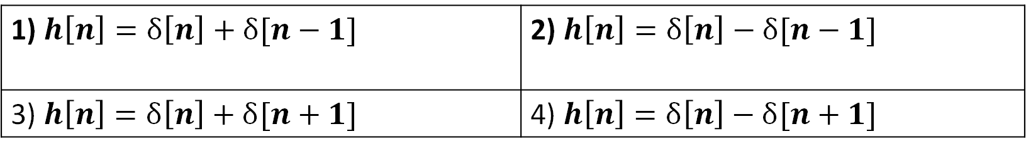
Find the impulse response
Delay
1) $h\left[n\right]=δ\left[n\right]+δ[n−1]$ | 2) $h\left[n\right]=δ\left[n\right]−δ[n−1]$
3) $h\left[n\right]=δ\left[n\right]+δ[n+1]$ | 4) $h\left[n\right]=δ\left[n\right]−δ[n+1]$

Slide 5
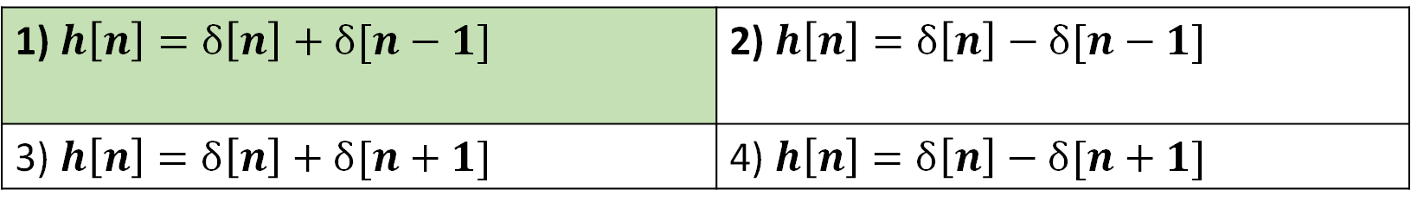
Find the impulse response
Delay
1) $h\left[n\right]=δ\left[n\right]+δ[n−1]$ | 2) $h\left[n\right]=δ\left[n\right]−δ[n−1]$
3) $h\left[n\right]=δ\left[n\right]+δ[n+1]$ | 4) $h\left[n\right]=δ\left[n\right]−δ[n+1]$

Slide 6
Basic DT system
Basic characteristics:
Linear
Time-Invariant
Causal
Constraint/feedback system
IIR system
p_{o}
Delay

Slide 7

Basic DT system
$$h\left[n\right]=?$$
p_{o}
Delay

Slide 8
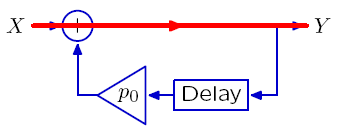
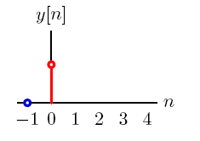
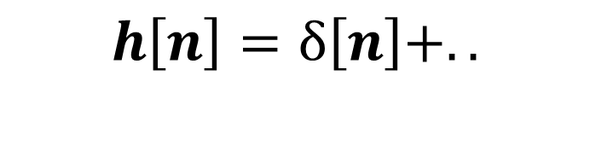
Basic DT system (Graphical method)
$$h\left[n\right]=δ\left[n\right]+..$$

Slide 9
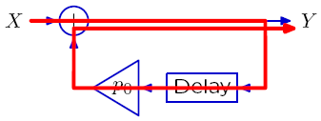
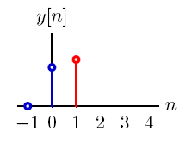
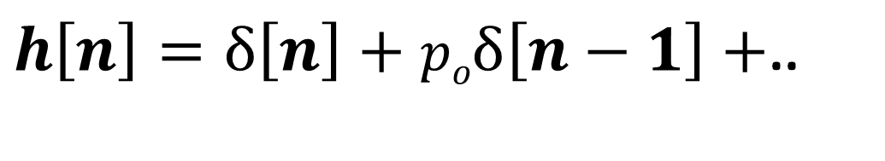
Basic DT system (Graphical method)
$h\left[n\right]=δ\left[n\right]+poδ\left[n−1\right]+$..

Slide 10
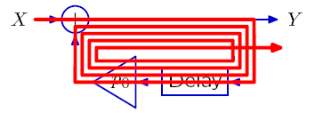
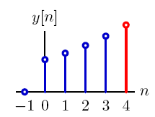

Basic DT system (Graphical method)
$$h\left[n\right]={\left(po\right)}^{n}u\left[n\right]$$

Slide 13

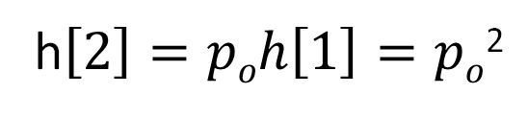
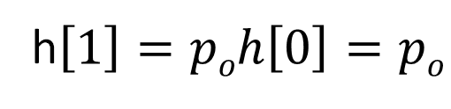
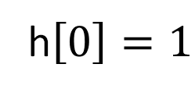
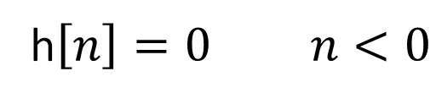
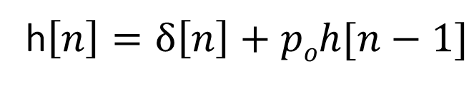
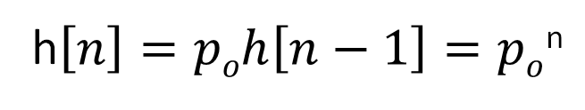
Basic DT system
(Step-by-step)
$$y\left[n\right]=x\left[n\right]+poy[n−1]$$
h$\left[n\right]=δ\left[n\right]+poh[n−1]$
$$h\left[n\right]=?$$
h$\left[n\right]=0 n<0$
h$\left[0\right]=1$
h$\left[1\right]=poh\left[0\right]=po$
h$\left[2\right]=poh\left[1\right]=po$²
p_{o}
Delay
h$\left[n\right]=poh\left[n−1\right]=po$^{n}

Slide 14

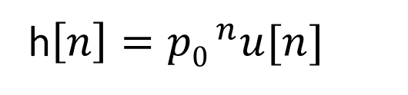


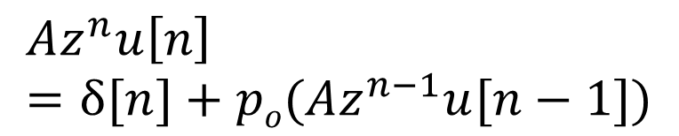
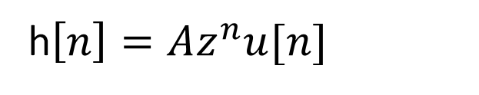
Basic DT system
(Guess-method)
$$y\left[n\right]=x\left[n\right]+poy[n−1]$$
h$\left[n\right]=Az^{n}u[n]$
$$h\left[n\right]=?$$
$$Az^{n}u\left[n\right]=δ[n]+po(Az^{n−1}u[n−1])$$
$$n=0 A=1$$
$$n=1 z=p0$$
h$\left[n\right]={p0 }^{n}u[n]$
p_{o}
Delay

Slide 15

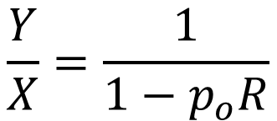


Basic DT system
(Polynomials)
$$y\left[n\right]=x\left[n\right]+poy[n−1]$$
$$Y=X+poRY$$
$$h\left[n\right]=?$$
$$Y(1−poR)=X$$
$$\frac{Y}{X}=\frac{1}{1−p_{o}R}$$
p_{o}
Delay

Slide 16

Synthetic Division
$$1−poR$$
1

Slide 17
Synthetic Division
1
$$1−poR$$
1

Slide 18


Synthetic Division
1
$$1−poR$$
1
$$1−poR$$
$$poR$$

Slide 19
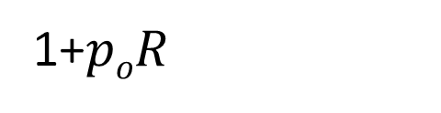


Synthetic Division
1+$poR$
$$1−poR$$
1
$$1−poR$$
$$poR$$
$$poR−po2R^{2}$$
$$po2R^{2}$$

Slide 20
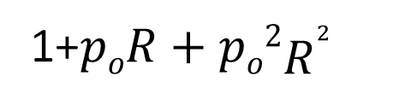
Synthetic Division
1+$poR+po2R^{2}$
$$1−poR$$
1
$$1−poR$$
$$poR$$
$$poR−po2R^{2}$$
$$po2R^{2}$$

Slide 21

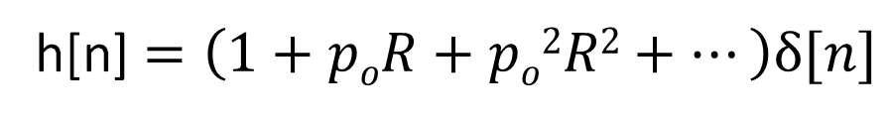
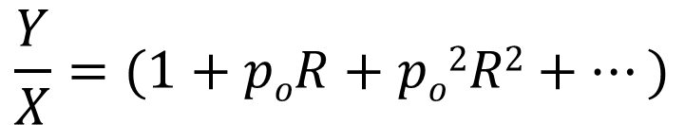
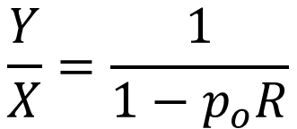


Basic DT system
(Polynomials)
$$y\left[n\right]=x\left[n\right]+poy[n−1]$$
$$Y=X+poRY$$
$$h\left[n\right]=?$$
$$Y(1−poR)=X$$
$$\frac{Y}{X}=\frac{1}{1−p_{o}R}$$
$$\frac{Y}{X}=(1+poR+po2R2+…)$$
p_{o}
Delay
h[n]$=\left(1+poR+po2R2+…\right)δ[n]$

Slide 22
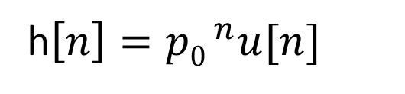
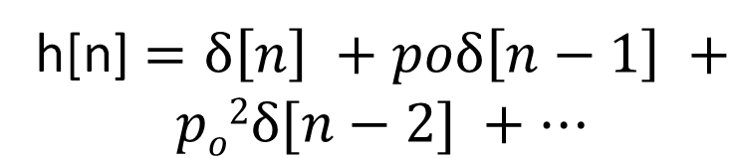
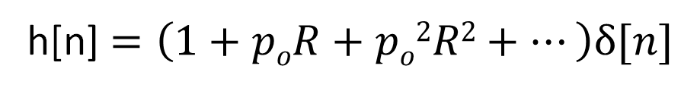
Basic DT system
(Polynomials)
$$y\left[n\right]=x\left[n\right]+poy[n−1]$$
h[n]$=\left(1+poR+po2R2+…\right)δ[n]$
$$h\left[n\right]=?$$
h[n]$=δ\left[n\right] +poδ\left[n−1\right] +$
$$po2δ[n−2] +…$$
h$\left[n\right]={p0 }^{n}u[n]$
p_{o}
Delay

Slide 23
Different approaches
Graphical method
Step-by-step method
Guess method
Polynomial approach

Slide 24






Polynomials
$$x[n]$$
Delay
$$y[n]$$
$$x[n]$$
$$y[n]$$
2
2
1
1
1
1
$0$ 1 2
$1$ 2 3
$$n$$
$$n$$

Slide 25

Polynomials
$$x[n]$$
Delay
$$y[n]$$
$$Y=RX$$
$$x[n]$$
$$y[n]$$
2
2
1
1
1
1
$0$ 1 2
$1$ 2 3
$$n$$
$$n$$

Slide 26


Polynomials
$$x[n]$$
Delay
$$y[n]$$
$$Y=RX$$
$$x[n]$$
$$y[n]$$
$$X=1+2R+R^{2}$$
$$Y=R+2R^{2}+R^{3}$$
$0$ 1 2
$1$ 2 3
$$n$$
$$n$$

Slide 27
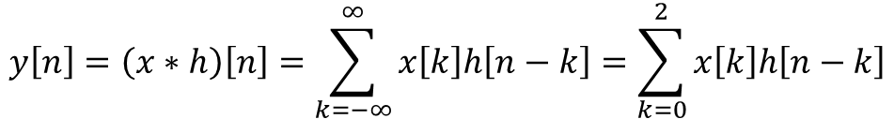




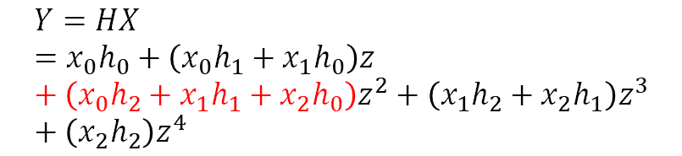

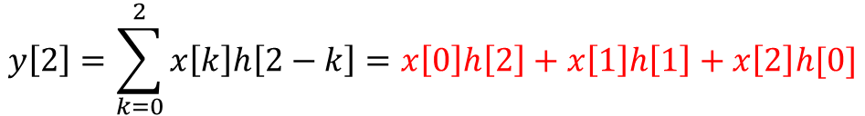
Why does polynomial method works?
$$h[n]$$
$$y[n]$$
$$x[n]$$
Polynomials
Convolution
$$y\left[n\right]=\left(x∗h\right)\left[n\right]=\sum_{k=−∞}^{∞}{x\left[k\right]h\left[n−k\right]=\sum_{k=0}^{2}{x\left[k\right]h\left[n−k\right]}}$$
$$X=x_{o}+x_{1}z+x_{2}z^{2}$$
$$H=h_{o}+h_{1}z+h_{2}z^{2}$$
$$Y=HX=x_{0}h_{0}+\left(x_{0}h_{1}+x_{1}h_{0}\right)z+\left(x_{0}h_{2}+x_{1}h_{1}+x_{2}h_{0}\right)z^{2}+\left(x_{1}h_{2}+x_{2}h_{1}\right)z^{3}+\left(x_{2}h_{2}\right)z^{4}$$
$$y\left[2\right]=\sum_{k=0}^{2}{x\left[k\right]h\left[2−k\right]}=x\left[0\right]h\left[2\right]+x\left[1\right]h\left[1\right]+x\left[2\right]h[0]$$

Slide 28
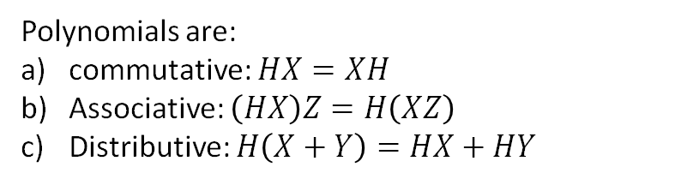
Why does polynomial method works?
$$h[n]$$
$$y[n]$$
$$x[n]$$
Polynomials
Convolution
$$y\left[n\right]=\left(x∗h\right)\left[n\right]=\sum_{k=−∞}^{∞}{x\left[k\right]h\left[n−k\right]=\sum_{k=0}^{2}{x\left[k\right]h\left[n−k\right]}}$$
$$X=x_{o}+x_{1}z+x_{2}z^{2}$$
$$H=h_{o}+h_{1}z+h_{2}z^{2}$$
Polynomials are:
commutative: $HX=XH$
Associative: $\left(HX\right)Z=H\left(XZ\right)$
Distributive: $H\left(X+Y\right)=HX+HY$
Convolution is:
Commutative
Associative
Distributive

Slide 29
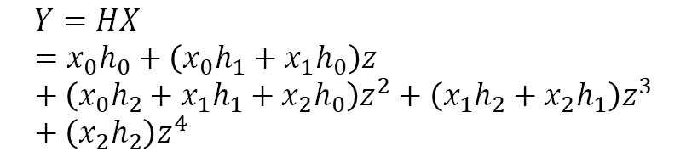
Why does polynomial method works?
$$h[n]$$
$$y[n]$$
$$x[n]$$
Polynomials
$$X=x_{o}+x_{1}z+x_{2}z^{2}$$
$$H=h_{o}+h_{1}z+h_{2}z^{2}$$
$$Y=HX=x_{0}h_{0}+\left(x_{0}h_{1}+x_{1}h_{0}\right)z+\left(x_{0}h_{2}+x_{1}h_{1}+x_{2}h_{0}\right)z^{2}+\left(x_{1}h_{2}+x_{2}h_{1}\right)z^{3}+\left(x_{2}h_{2}\right)z^{4}$$

Slide 30
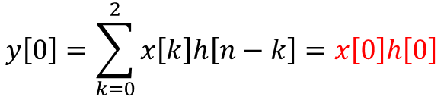
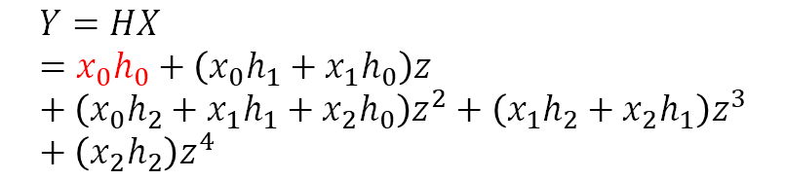
Why does polynomial method works?
$$h[n]$$
$$y[n]$$
$$x[n]$$
Polynomials
Convolution
$$y\left[n\right]=\left(x∗h\right)\left[n\right]=\sum_{k=−∞}^{∞}{x\left[k\right]h\left[n−k\right]=\sum_{k=0}^{2}{x\left[k\right]h\left[n−k\right]}}$$
$$X=x_{o}+x_{1}z+x_{2}z^{2}$$
$$H=h_{o}+h_{1}z+h_{2}z^{2}$$
$$y\left[0\right]=\sum_{k=0}^{2}{x\left[k\right]h\left[n−k\right]}=x\left[0\right]h\left[0\right]$$
$$Y=HX=x_{0}h_{0}+\left(x_{0}h_{1}+x_{1}h_{0}\right)z+\left(x_{0}h_{2}+x_{1}h_{1}+x_{2}h_{0}\right)z^{2}+\left(x_{1}h_{2}+x_{2}h_{1}\right)z^{3}+\left(x_{2}h_{2}\right)z^{4}$$

Slide 31
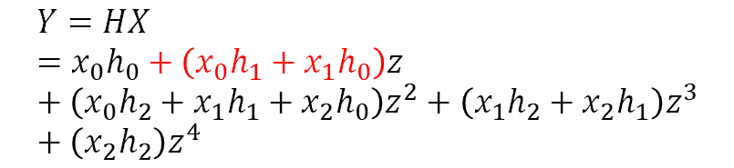
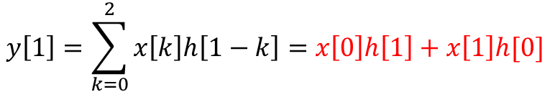
Why does polynomial method works?
$$h[n]$$
$$y[n]$$
$$x[n]$$
Polynomials
Convolution
$$y\left[n\right]=\left(x∗h\right)\left[n\right]=\sum_{k=−∞}^{∞}{x\left[k\right]h\left[n−k\right]=\sum_{k=0}^{2}{x\left[k\right]h\left[n−k\right]}}$$
$$X=x_{o}+x_{1}z+x_{2}z^{2}$$
$$H=h_{o}+h_{1}z+h_{2}z^{2}$$
$$Y=HX=x_{0}h_{0}+\left(x_{0}h_{1}+x_{1}h_{0}\right)z+\left(x_{0}h_{2}+x_{1}h_{1}+x_{2}h_{0}\right)z^{2}+\left(x_{1}h_{2}+x_{2}h_{1}\right)z^{3}+\left(x_{2}h_{2}\right)z^{4}$$
$$y\left[1\right]=\sum_{k=0}^{2}{x\left[k\right]h\left[1−k\right]}=x\left[0\right]h\left[1\right]+x\left[1\right]h[0]$$

